Slide 1

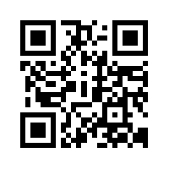
Graduate Engineering & Science Students Association
brings you selected content from your favorite FB page
Launchpad
@ ASU
Learn from Alumni about
What courses are good for you?
Tips for getting part time jobs.
How to get an Internship?
How to prepare for full time jobs?
List of hiring engineering companies.
List of companies providing H1B visas.
Dos and donts for interviews.
http://gessa.org/launchpad

